Slide 1
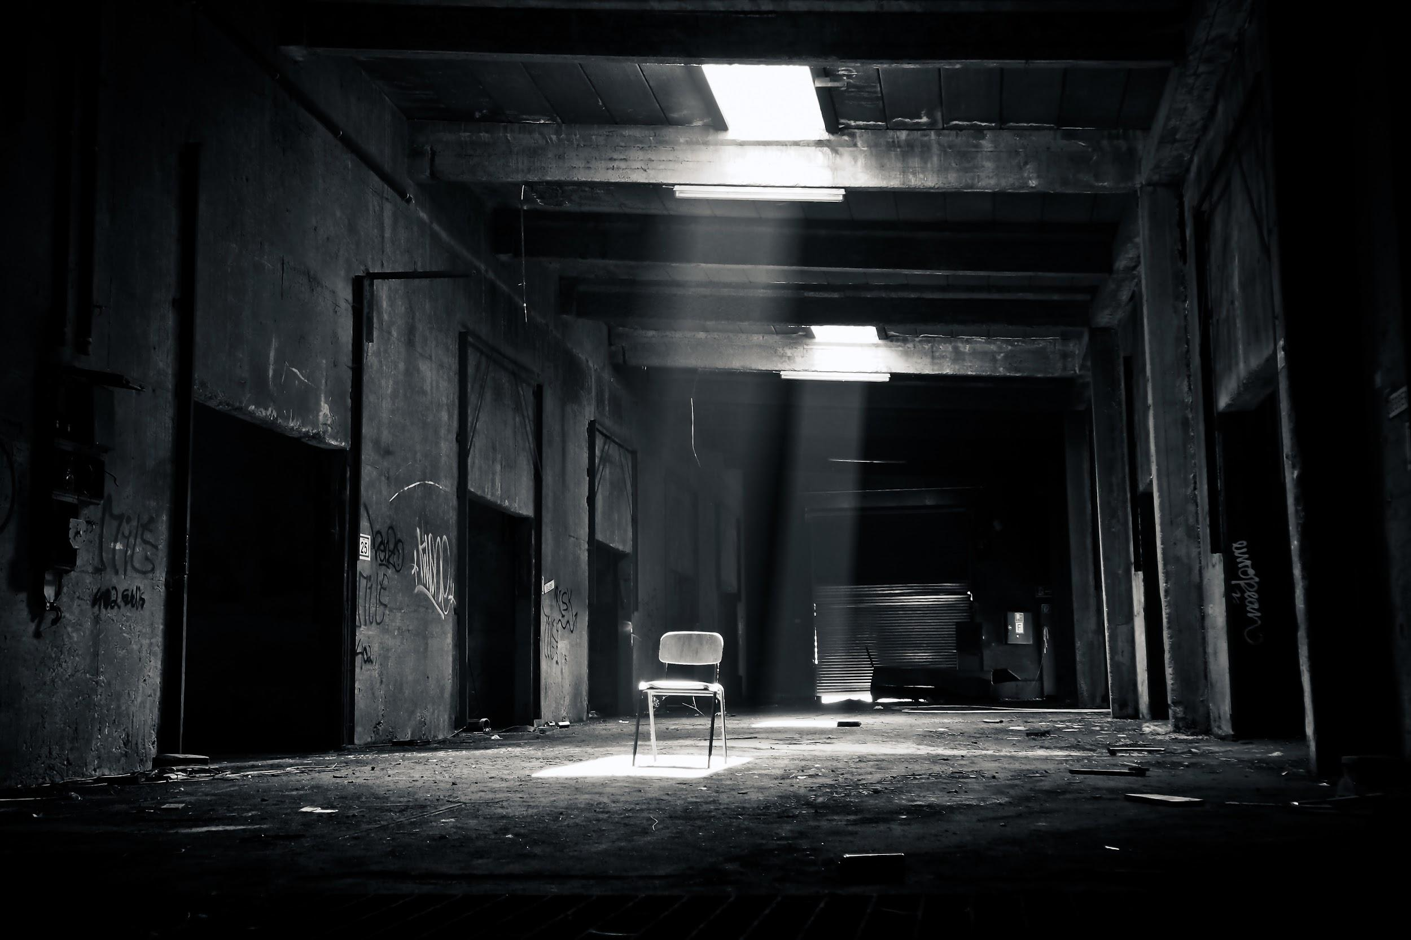
Death By Meme
By:
Lindsay Hilliard
Jourdan Watson

Slide 2
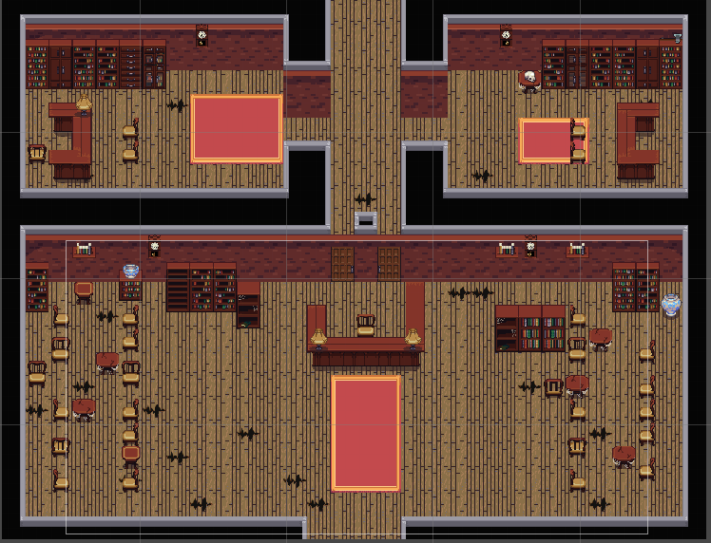

Slide 3
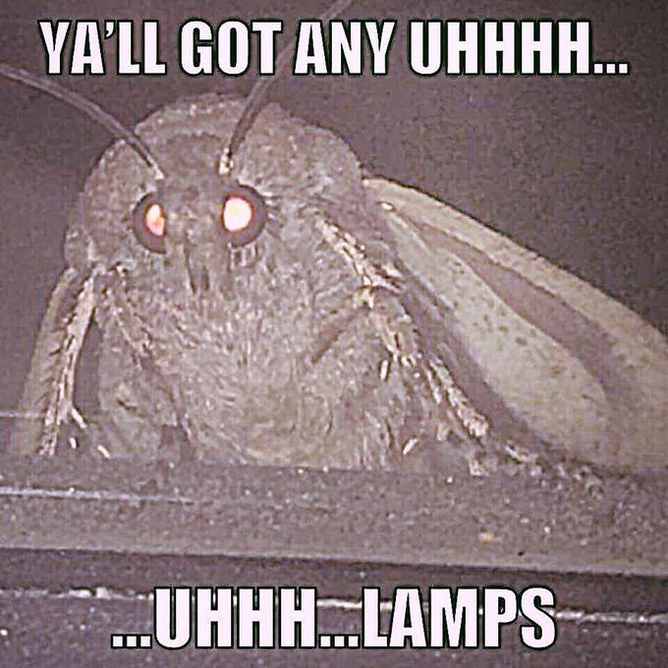
Concept:
Combines horror and humor genres
Places player into an insane asylum setting, trying to find a way out
Only has a flashlight
Turns meme characters into game enemies

Slide 4
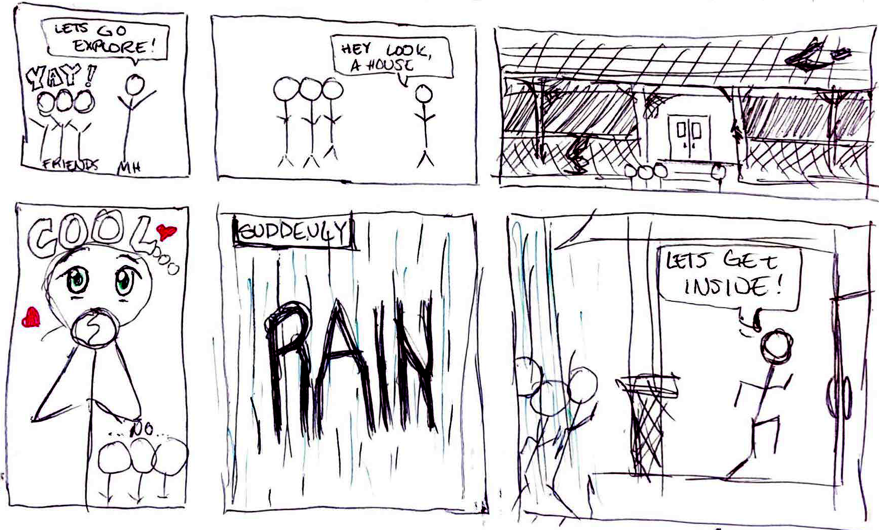
Storyboard:

Slide 5
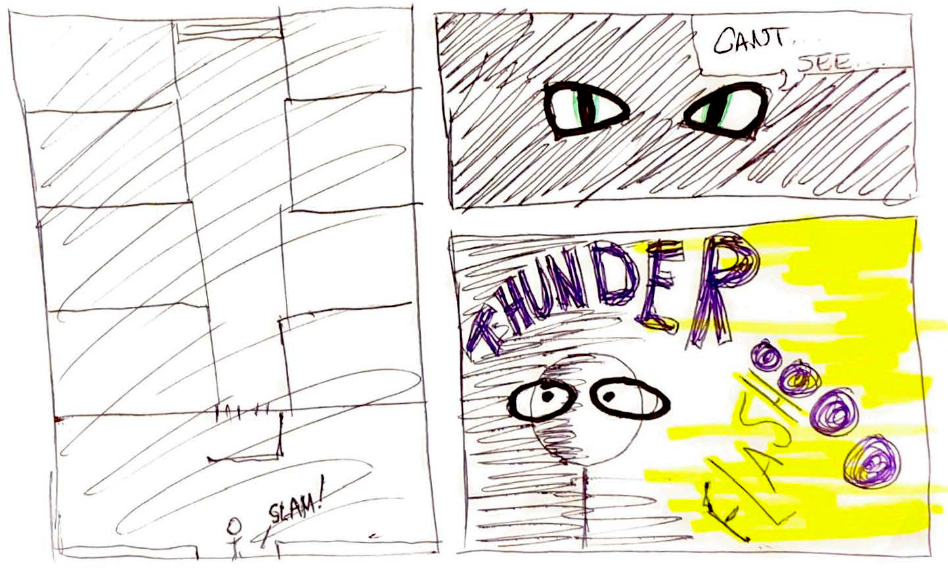
Storyboard:

Slide 6
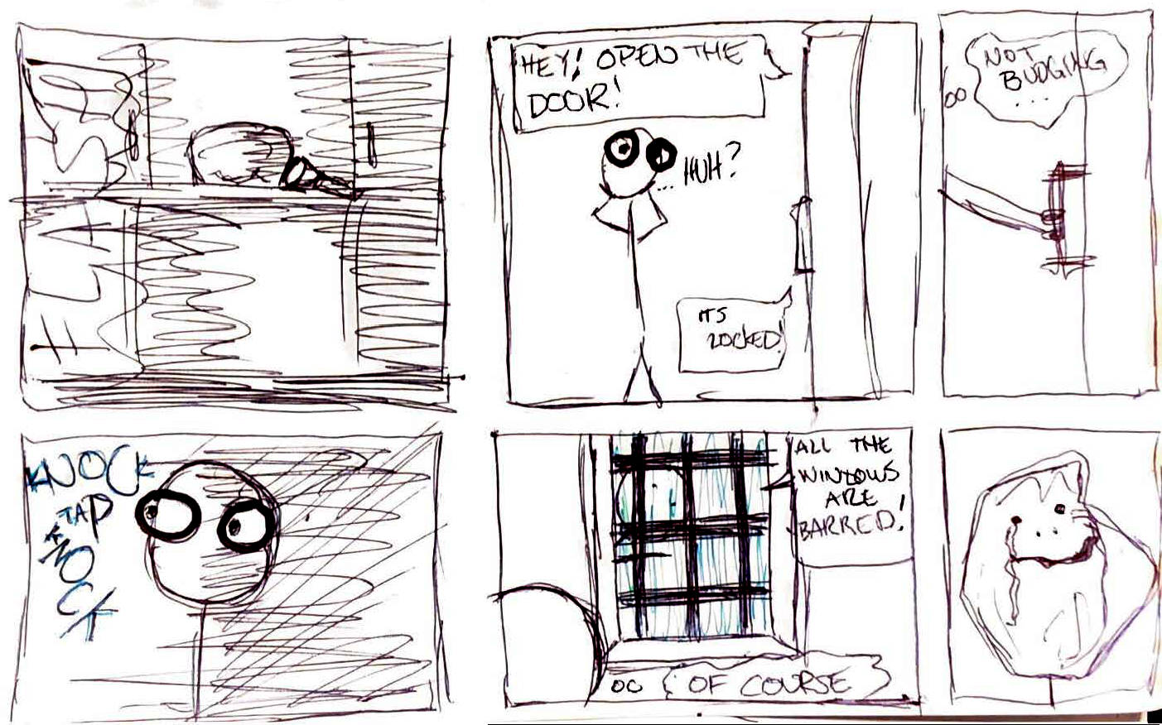
Storyboard:

Slide 7
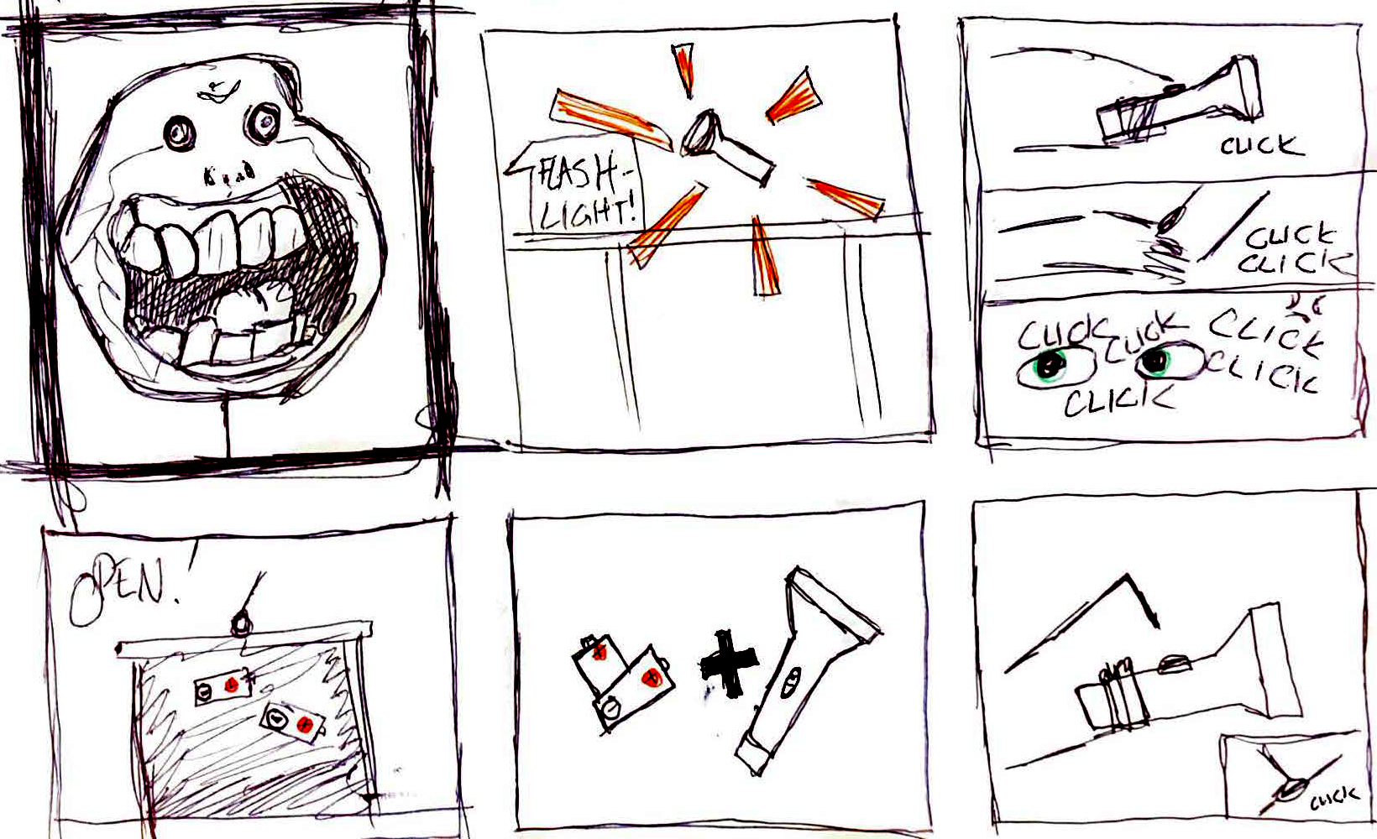
Storyboard:

Slide 8
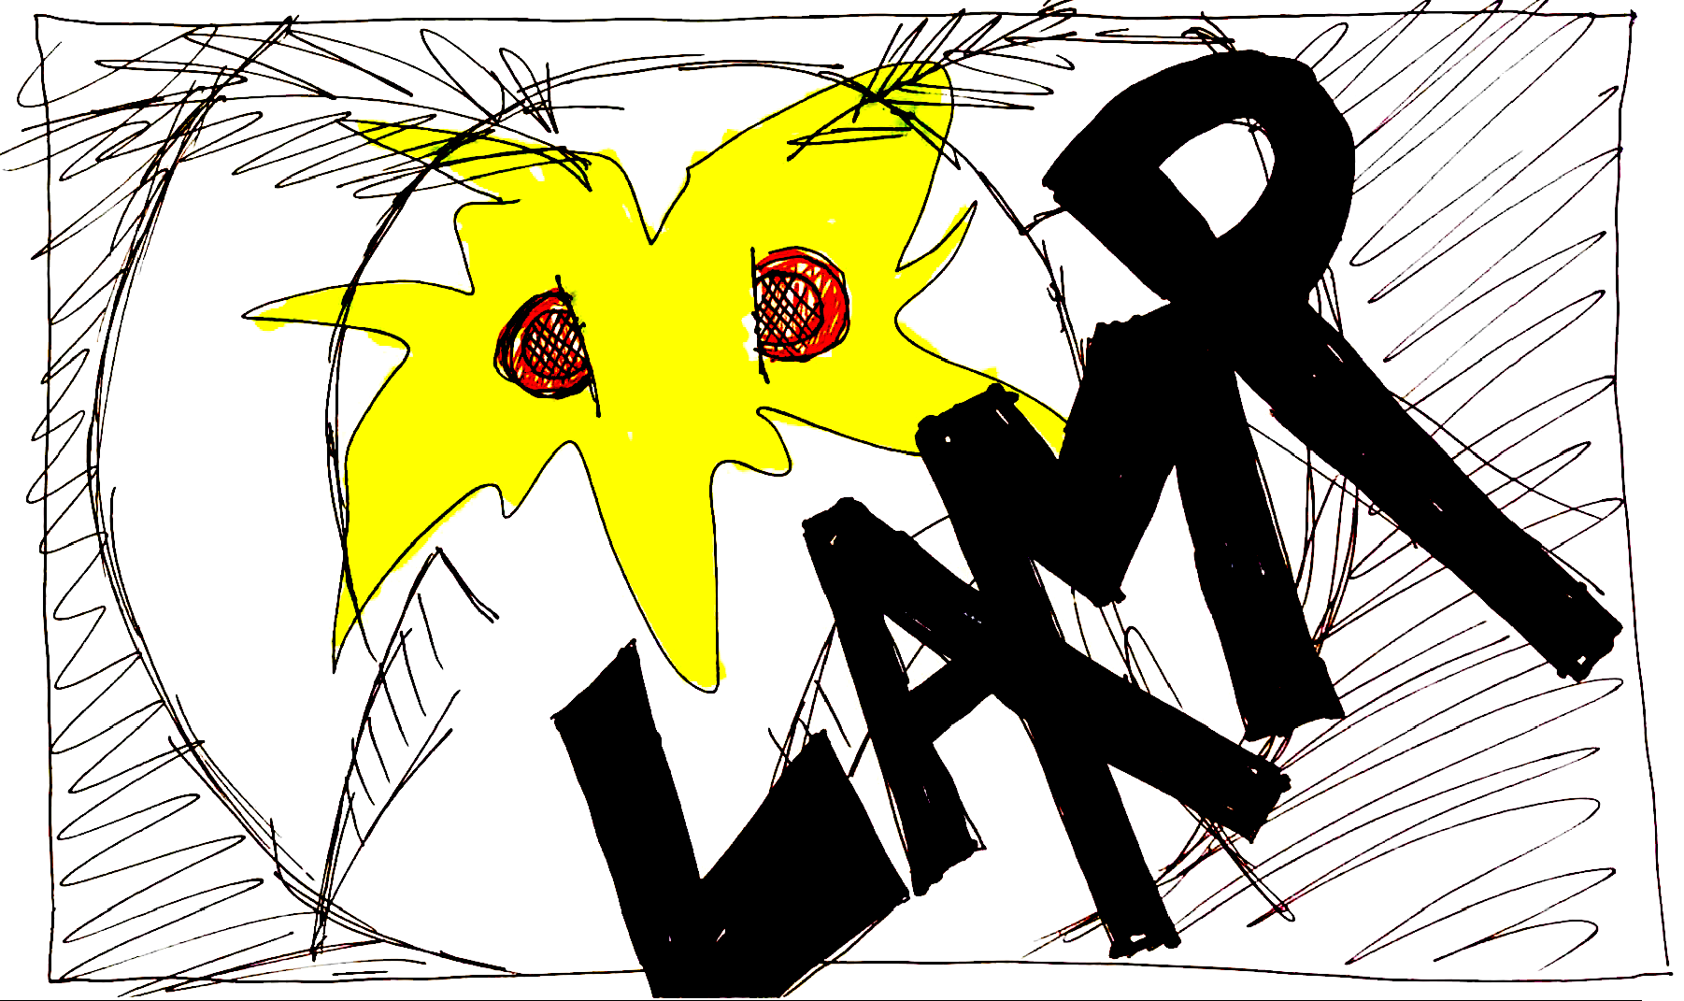
Storyboard:

Slide 9
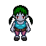

Unique Selling Points:
Memes
Retro game style
Staying too long in one place can kill you (battery life)
Crossing certain doorways causes more enemies to spawn
New enemies per level

Slide 10
Game Play:
Appearance:
Insane asylum setting
Rooms with old furniture and medical equipment
Top-down view of player’s map
Audio:
Background music
Sound effects to add to ambiance

Slide 11
Player Role & Actions:
The player is on a quest to find an exit to escape from the building
The player may only avoid enemies and not engage while attempting to escape
Light attracts enemies, but cannot see much without the flashlight
Player can run, but will risk visibility

Slide 12
Strategies & Motivation:
Use rooms to escape from enemies
Listen for noises to let you know when enemies are close without light
Use light to identify doors and other objects, or risk making noise yourself

Slide 13
Level Summary:
The first level takes place on the first floor of the asylum
The player enters the lobby with a reception desk, bookshelves and other typical lobby decor
From there, the player can progress to a series of patient intake rooms
These rooms have desks, chairs and other decorations
After the player progresses past these rooms, there are patient evaluation rooms on either side of the hallway
Finally, at the end of the hallway, there is a staircase

Slide 14
Questions?

